Slide 1

Plant disease detection using CNN and implementing using react JS and react Native
By Jayshil Patel(18EC068), guided by Prof. Vishal Tank
V. T. Patel Department of
Electronics and Communication Engineering

Slide 2
Introduction:-
Goal
Improve UI and UX for the farmers
Connect Backend and Frontend
Technologies used
Frontend
React JS
CSS
HTML
Postman
NodeJS
Backend
Python
CNN
Docker
TF Serving

Slide 3
Project Architecture
Detection and classification
TensorFlow (machine learning library developed by Google) will be used to train and save the model
Dataset
2152 images of 3 categories is used to train the model. This dataset is fetched from Kaggle open source
Frontend deployment
Website made using ReactJS is used to build the website. FastAPI is used to connect frontend and the backend
Future development
This entire project can be uploaded to a server, namely GCP or AWS to make it globally accessible.
React native app can be deployed to make it more accessible to general public.

Slide 4
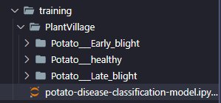
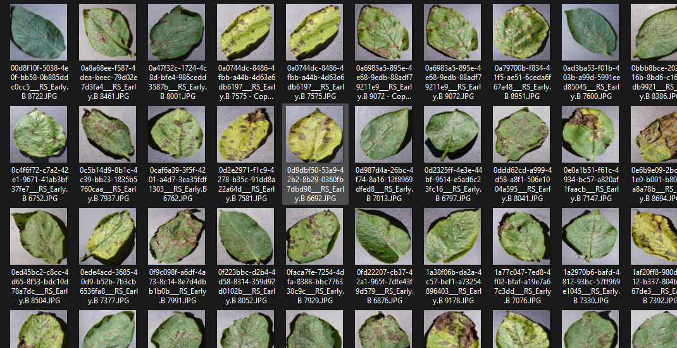
Dataset imported from kaggle
2152 Images classified into :-
1000x Potato early blight
1000x Potato late blight
152x Healthy leaf images

Slide 5
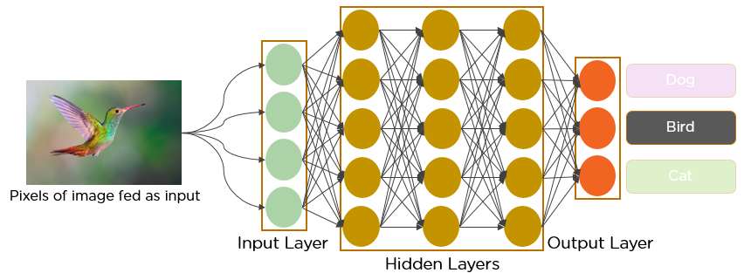
What is CNN?

Slide 6
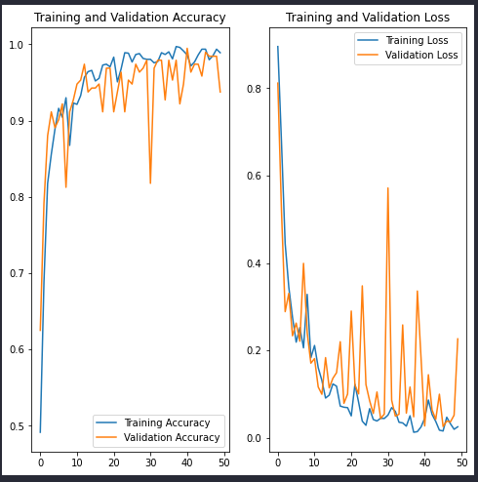
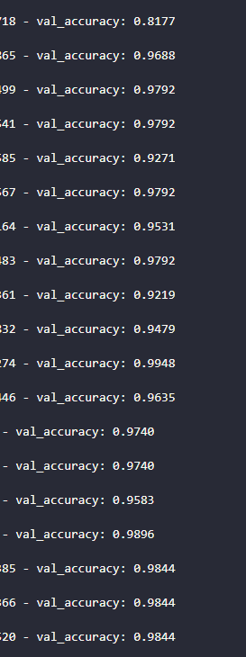
Accuracy of the model

Slide 7
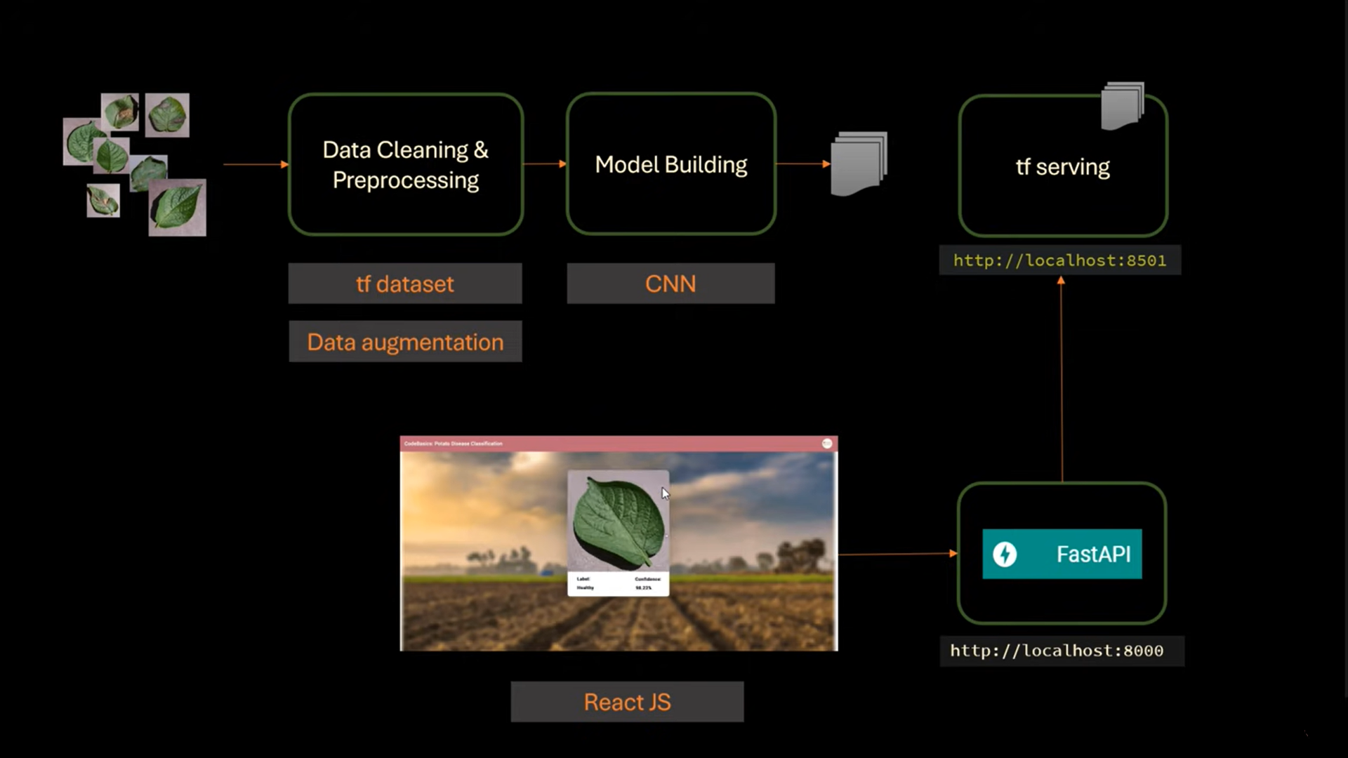
Workflow

Slide 8
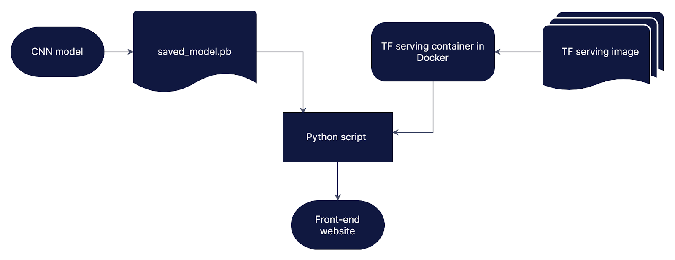
Backend Architecture

Slide 9
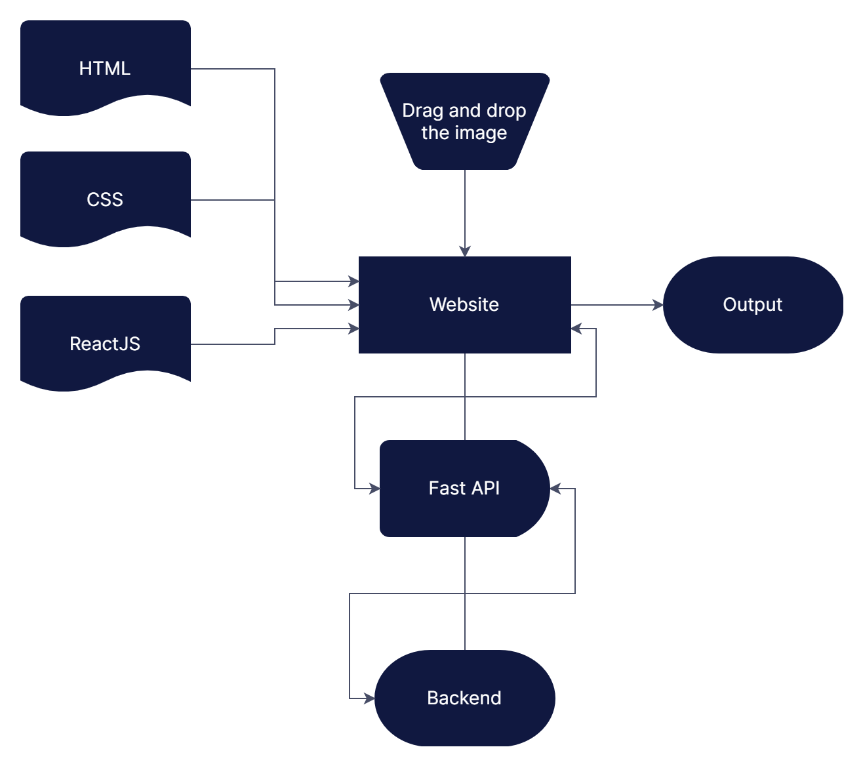
Frontend Architecture

Slide 10
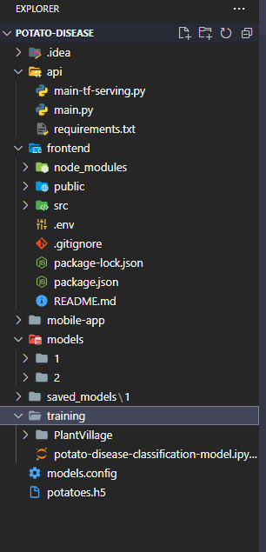
Directory Structure:

Slide 11
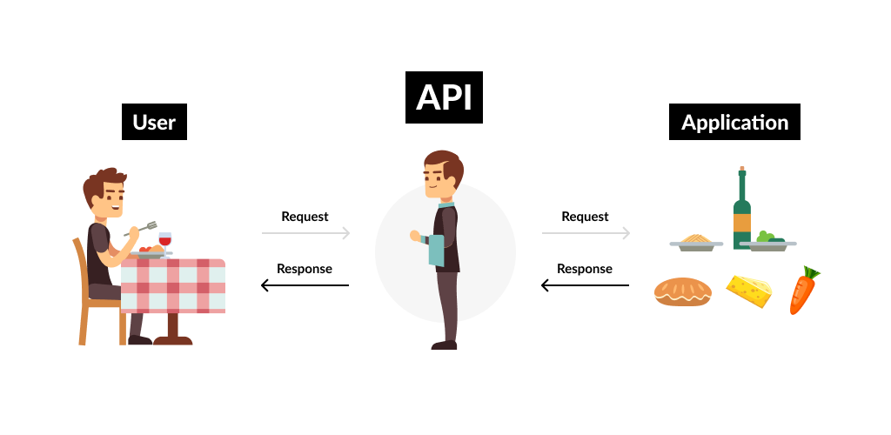
How APIs work

Slide 12
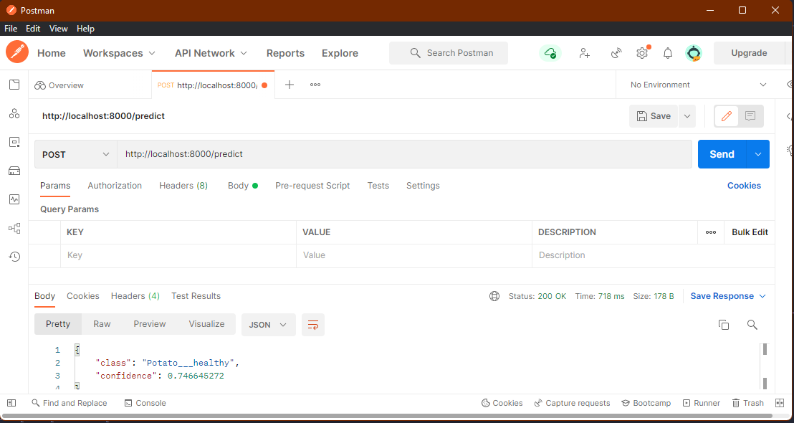
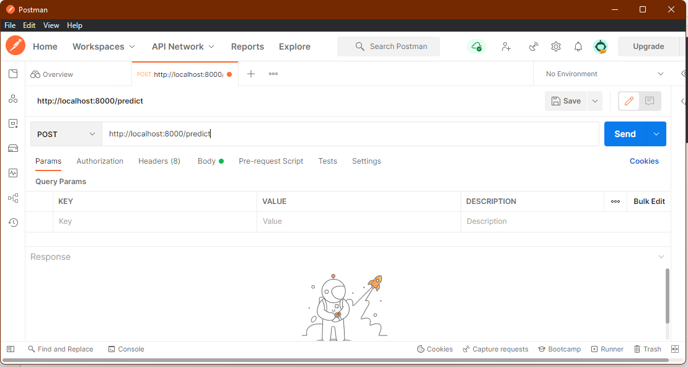
Application using Postman

Slide 13
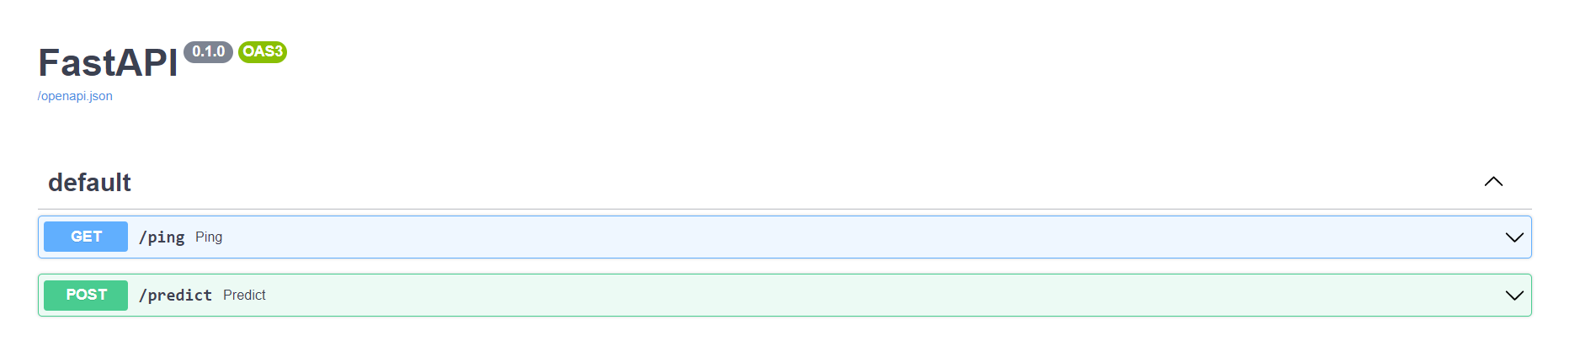
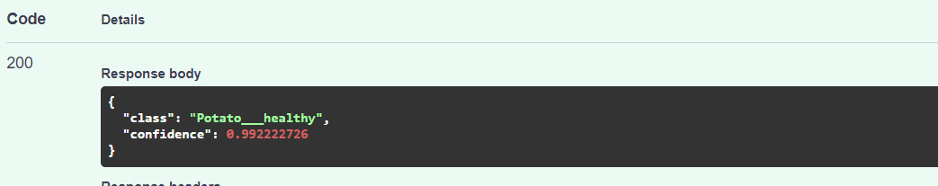
Application using Fast API documentation

Slide 14
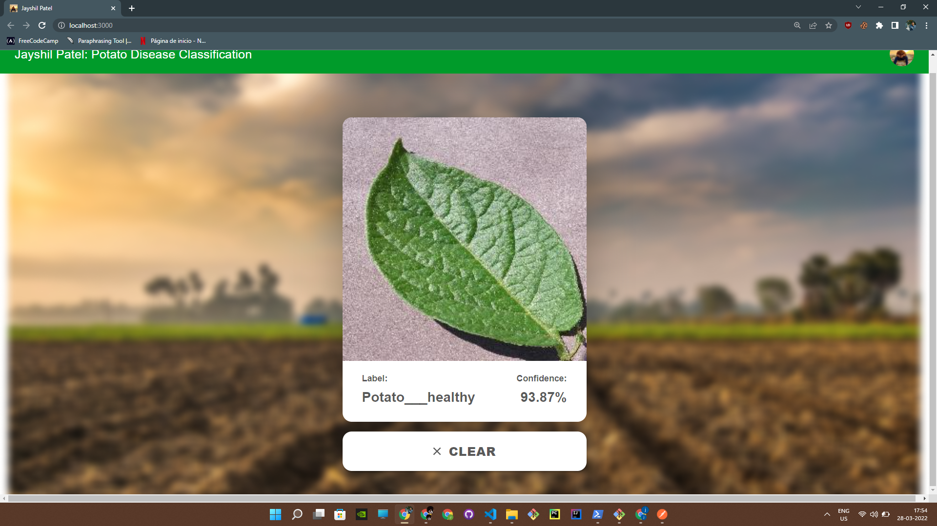
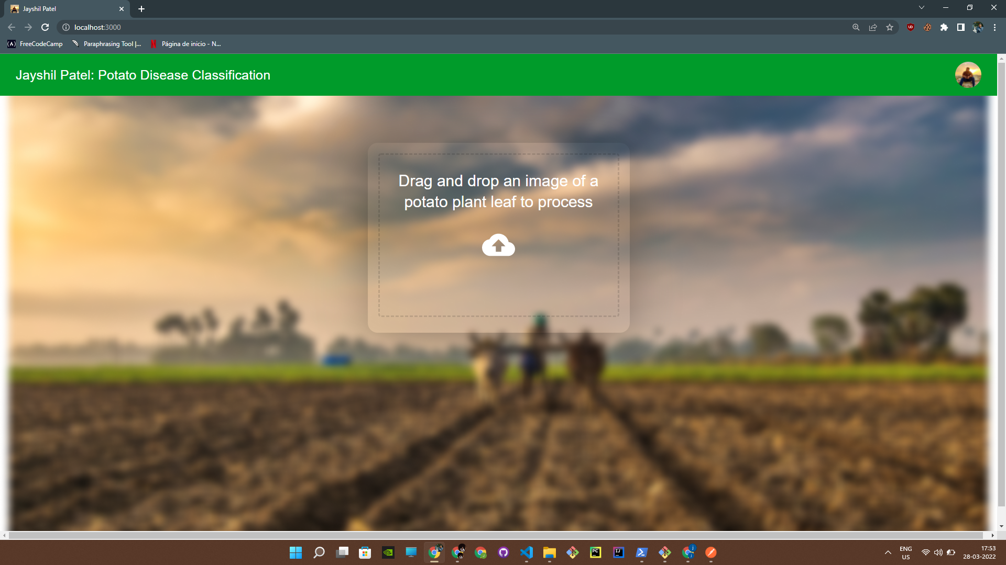
Application using React website

Slide 15
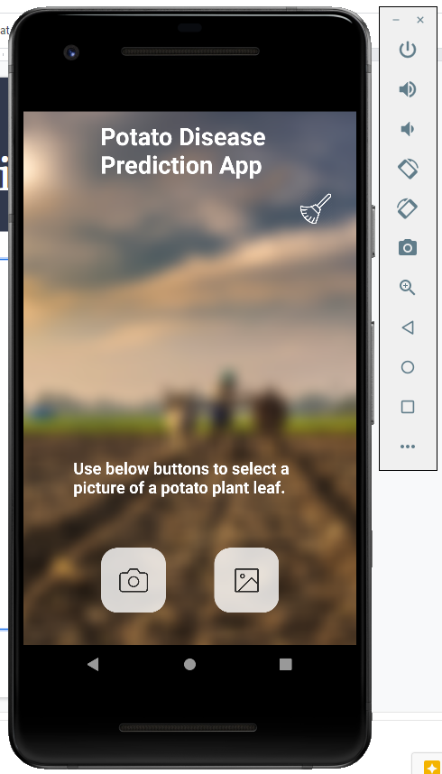
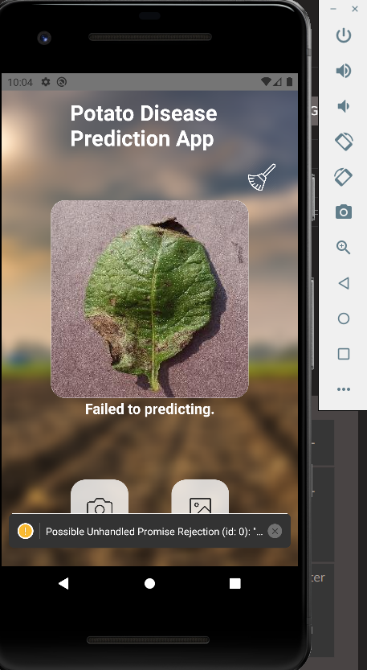
Error while deploying mobile application
Need a cloud server
Cloud server :- AWS, GCP, Azure
Errors in implementation

Slide 16
References
Dataset:- https://www.kaggle.com/muhammadardiputra/potato-leaf-disease-dataset
CNN:- https://www.youtube.com/watch?v=Mubj_fqiAv8&list=PLeo1K3hjS3uu7CxAacxVndI4bE_o3BDtO
HTML & CSS:- https://www.freecodecamp.org/learn/responsive-web-design/
Javascript :- https://www.freecodecamp.org/learn/javascript-algorithms-and-data-structures/
React JS:- https://www.freecodecamp.org/learn/front-end-development-libraries/#react-and-redux
Docker:-
https://docs.docker.com/get-started
Query Solving:-
https://stackoverflow.com/users/15609296/jayshil-patel
Postman:-
https://www.javatpoint.com/postman
FastAPI:-
https://fastapi.tiangolo.com/tutorial/first-steps/

